Slide 1
Comparison Among Protein-Protein interactions:
A Computational Approach
Under Guidance of : Prof. Sankhayan Choudhury
DEPARTMENT OF COMPUTER SCIENCE AND ENGINEERING,
UNIVERSITY OF CALCUTTA

Slide 2
Dipankar Pal
Nabanita Dey
Samprita Roy Choudhury
M.SC 2nd year, 3rd semester
in Computer Science
UNIVERSITY OF CALCUTTA
sampritarc97@gmail.com
M.SC 2nd year, 3rd semester
in Computer Science
UNIVERSITY OF CALCUTTA
d.pal5050@gmail.com
M.SC 2nd year, 3rd semester
in Computer Science
UNIVERSITY OF CALCUTTA
nabanitadey825@gmail.com

Slide 3
Motivation
In order to better understand several cellular processes, it is helpful to study how various components make up the system.
Working with whole organisms (or even just whole cells) can be unpredictable, with the outcome of experiments relying on the interaction of thousands of molecular pathways and external factors.
The molecules which form the basis of life provide a more predictable and mechanistic tool for us to study.
We may use them to determine the function of single genes or proteins, and find out what would happen if that gene or protein was absent or faulty.
Knowledge to develop treatments for when living things don’t work so well.
Networks of protein–protein interactions (PPI networks) offer a way to depict, visualize and quantify the functioning and relative importance of particular proteins in cell function.
Such network analysis can be used, in general to support predictions in pathogenesis studies.
To understand a protein's function and behaviour.
To predict the biological processes that a protein of unknown function is involved in.

Slide 4
Biological molecules
Large molecules that are abundantly found in living organisms and are essential for life.
There are four major types of biological molecules -
(Carbohydrates, Fats, proteins, Nucleic Acids)
Here in this work we are concerned about Proteins only.

Slide 5
Gene Expression
When the information stored in our DNA is converted into instructions for making proteins or other molecules, it is called gene expression.
Several steps in the gene expression process may be modulated, including the transcription, RNA splicing, translation, and post-translational modification of a protein
01
04
Gene expression is a tightly regulated process that allows a cell to respond to its changing environment.
02
The process of gene expression is used by all known life—eukaryotes (including multicellular organisms), prokaryotes (bacteria and archaea), and utilized by viruses—to generate the macromolecular machinery for life.
05
It acts as both an on/off switch to control when proteins are made and also a volume control that increases or decreases the amount of proteins made.
03

Slide 6
Purine And Pyrimidine
Purine and pyrimidine are fundamental components of nucleotides in DNA and RNA and are essential for the storage of information in the cell.
Purine bases in DNA include Adenine (A) and Guanine (G) .
Pyrimidine bases in DNA include Cytosine( C) and Thymine (T) .

Slide 7
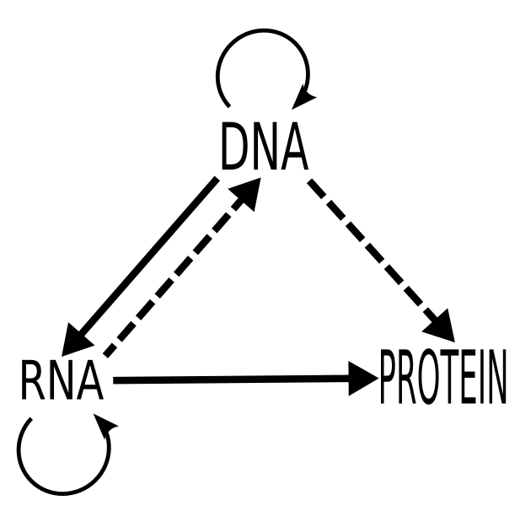
Central Dogma
A Framework For Understanding The Transfer Of Information Between DNA, RNA, And Proteins.
The Transfer Of Information From Nucleic Acid To Nucleic Acid, Or From Nucleic Acid To Protein May Be Possible, But Transfer From Protein To Protein, Or From Protein To Nucleic Acid Is Impossible.
Information Means Here The Precise Determination Of Sequence, Either Of Bases In The Nucleic Acid Or Of Amino Acid Residues In The Protein.
Flow Of Information
source: Wikipedia

Slide 8
Three Classes Of Central Dogma
DNA are copied to DNA(DNA replication) or RNA are copied from RNA(RNA replication)
Replication
DNA information are copied into mRNA
Add transcription
Central Dogma
Transcription
It provides the basic framework for how genetic information flows from a DNA sequence to a protein product inside cells. This process of genetic information flowing from DNA to RNA to protein is called gene expression.
Add Contents Title
proteins are synthesized using the information present in mRNA.
Translation

Slide 9
DNA Replication
The Copying From DNA To DNA Arguably Is The Fundamental Step In The Central Dogma
The DNA Makes Multiple Copies Of Itself.
The Whole Process Takes Place With The Help Of Enzymes Where DNA-dependent DNA Polymerase Being The Chief Enzyme.

Slide 10
Transcription
Transcription Is The Process By Which The Information Contained In A Section Of DNA Is Replicated In The Form Of A Newly Assembled Piece Of Messenger RNA (mRNA).
Enzymes Facilitating The Process Include RNA Polymerase And Transcription Factors.
The Product Of The Entire Transcription Process (That Began With The Production Of The Pre-mRNA Chain) Is A Mature mRNA Chain.

Slide 11
Translation (Protein Synthesis)
The process by which the mRNA codes for a particular protein is known as Translation.
The ribosome translates the mRNA produced from DNA into a chain of specific amino acids.
This chain of amino acids leads to protein synthesis.
The whole machinery of translation is present in the ribosomes.

Slide 12
Codon
Cells decode mRNAs by reading their nucleotides (either a Purine or a Pyrimidine) in groups of three, called codons.
Most codons specify an amino acid. For example, the three bases ‘GGU’ code for an amino acid called glycine.
Three "stop" codons mark the end of a protein.
One "start" codon, AUG, marks the beginning of a protein and also encodes the amino acid methionine.
As there are only 20 amino acids but 64 potential combinations of codons, more than one codon can code for the same amino acid.
For example, the codons ‘GGU’ and ‘GGC’ both code for glycine. The full table for such mapping is shown next.

Slide 13
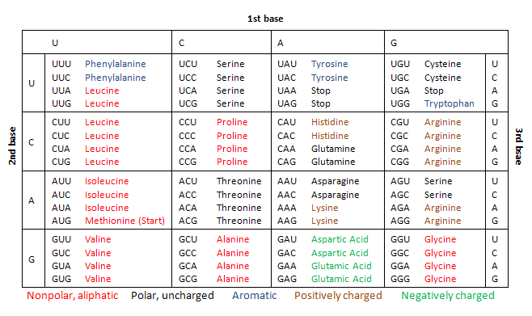
DNA Code Table
The complete set of relationships between codons and amino acids (or stop signals) is called the genetic code.
1 start codon (AUG) , 3 STOP codons ( UGA,UAA,UAG)
There 5 categories of Amino Acids-singlet,doublet,triplet,quartet and sextet.
Source: WikiMedia

Slide 14
Amino Acid
Building Blocks of Proteins.
There is a total of 20 Amino acids.
Biochemical properties: (Nonpolar, Polar, Basic, Acidic)
These chemical attributes of the amino acids of proteins determine the biological activity of the cells.

Slide 15
Proteins
Large,Complex Molecules That Play Crucial Role In The Body.
Linear Sequence Of Amino Acid residues (polypeptide) Determines Each Protein’s Unique 3D Structure And Its Specific Function.
Proteins can interact with many types of molecules, including with other proteins, with carbohydrates, and with DNA.
Proteins are assembled from amino acids using information encoded in genes.
Each protein has its own unique amino acid sequence that is specified by the nucleotide sequence of the gene encoding this protein.

Slide 16
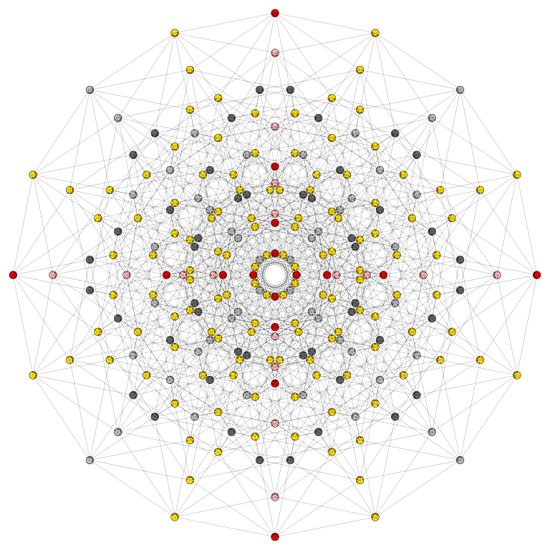
Protein-Protein Interconnection Network
A Mathematical Or Graphical Representation Of The Physical Contact Between More Than Two Proteins In A Cell.
Analysis On PPI Is Leading Us To Drug Development, Explore Facts About Some Unknown Syndromes, Understand Cell Psychology In Some Diseases, Characterize The Relationships Between Proteins, Explore Some Uncharacterized Proteins, Etc.
Analysis Of PPIs Are Done Graphically And Sequentially.
Here We Are Given 3 Genes (forms the responsible proteins) - PARKIN, PINK1 and DJ1 , which Are To Be Compared To The Other Genes Of The Network On The Basis Of The Two Above Said Approaches to get some insights about some diseases like PARKINSON DISEASE (progressive problems with movement and balance).

Slide 17
Problem Statement
We are to identify the similarities and dissimilarities among the Protein-Protein Interactions by means of purine-pyrimidine pairs applying two computational approaches -
Graphical
Linear

Slide 18
State of Art
The graphical approach provides the idea of Gene regulatory networks (GRN) that explicitly characterizes regulatory processes in cells typically modeled by graphs.
Studies of GRNs on colon cancer has been analysed recently.
Studies on the sequential approach of analyzing DNA sequences are to find out evolutionary relationships among DNA sequences finding similarity and dissimilarity throughout the various species is a straightforward way.
In recent days, DNA sequences have been analysed by the chemical proximity of each neighbour genes with all hub node (genes) within the subnetwork .
Generation of phylogenetic trees to get similarity matrix has been proposed as a phylogeny or evolutionary tree represents the evolutionary relationships among various biological speecies.

Slide 19
Solution Approach
We are given Amino Acid (AA) sequences of hub genes and genes in networks.
Step 1: The AA sequence is transferred into its numerical form as per the strength of the nucleotides (A=1, T=2, G=3, C=4).
Step 2: Now, we have 64 codons in the codon table as the codon is composed of the above-mentioned ATCG. Hence the numerical representation of 64 codons can be computed from step 1. Thus, a numeric representation of each codon specifies the unique determinative degree of it.
Step 3. 1. Represent the 64 codons of genetic code table based on the chemical classification of nucleotides i.e. purine and pyrimidine. From here we are getting those 64 codons distributed in 8 different types of patterns.
Step 3.2: Find the percentage of each pattern contributing to code for amino acids.
Step 4.1: To analyze given AA sequences in sequential level, we are supposed to perform the following:
Step 4.1.1: Read the Amino Acid sequences taken based on classification. Do multiple alignments of the given dataset using step 3.1.

Slide 20
Solution Approach
Step 4.1.2: Look for a common pattern at a common position among them
and the percentage of the presence of those common patterns in
sequence. This is to realize the proximity between the sequences.
Step 5.1: To realize the proximity,
1) the proximity between the hub gene and the other genes of the
network
2) the proximity between the genes which are common
3) the uniqueness of the taken hub genes (eg. PARKIN, PINK1,
DJ1 responsible for cancer)
Step 5.2: Now for network-level analysis, we are to conduct the following:
Step 5.2.1: The 8 types of patterns mentioned in step 3 are considered as
nodes here.

Slide 21
Solution Approach
Step 5.2.2: Construct directed multi-graph for each sequence.
Step 5.2.3: Comparison of the directed multi-graphs constructed.
Step 6: Investigate evolutionary relationships among the dataset taken.
Step 6.1: Derive Similarity/Dissimilarity Matrix of all AA Sequences taken
based on codon classes.
Step 6.2: Construct corresponding Phylogenetic Tree from the matrix
derived.

Slide 22
Conclusion
Protein-Protein Interaction Networks can help us to find characteristics of some diseases.
We can apply the knowledge of the PPIs involved in the syndrome to develop any possible drugs.
PARKIN, PINK1 and DJ1 are three Hub Genes responsible for generation of some proteins which play vital roles in different cancers.
Here in this work we try to analyze these 3 genes ( hence formed Proteins) with the help of PPI networks to find similarities or dissimilarities between them by applying Linear and Graphical Approaches.
As a result, we may come up with some unexplored insights that can lead us towards cure to the diseases.

Slide 23
Thank You

